Slide 1

South Africa Truth and Reconciliation Initiative
Haolin Guo

Slide 2
Overview
Utilize Machine Learning to Examine Racial Segregation Trends Over Time and Across Geographical Areas
Increase awareness of the issue and introduce the project to organizations combating racism
Investigate South Africa's racially biased political landscape during the Apartheid era by assessing regional disparities in segregation levels
Expand the conversation on race beyond African and African American populations

Slide 3
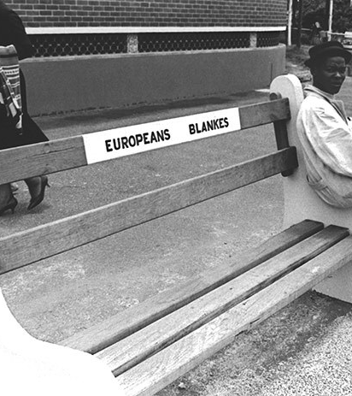
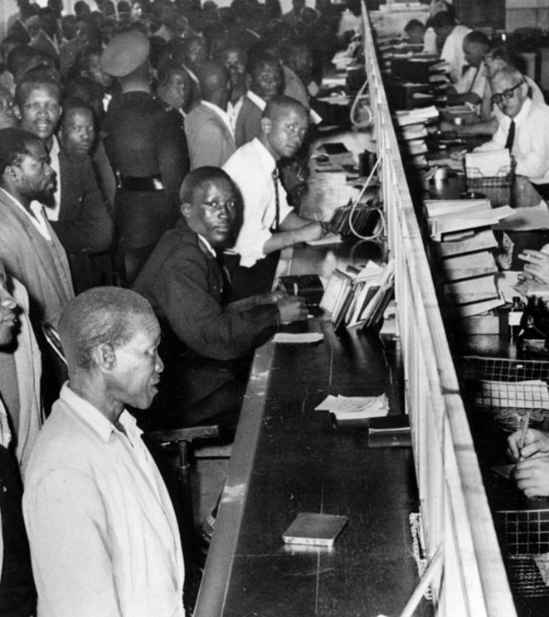
History of Segregation: Apartheid

Slide 4
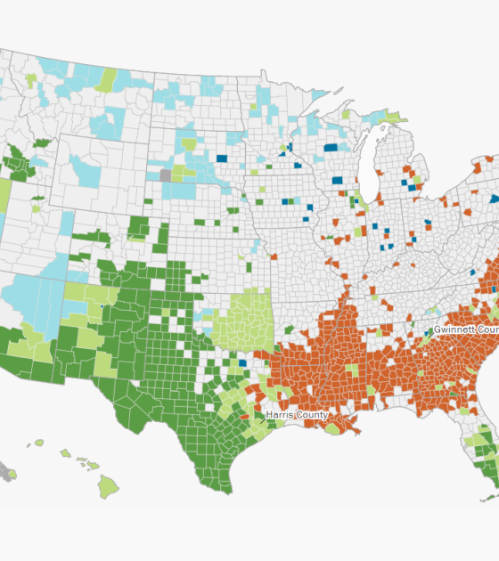
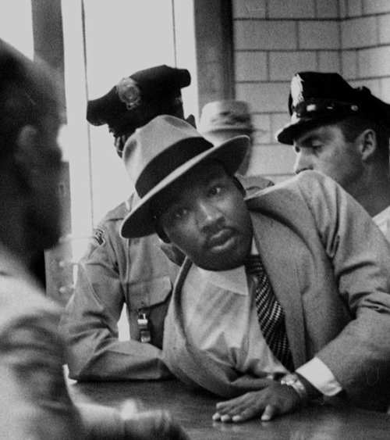
History of Segregation: USA

Slide 5



Roles
Programmers (ML, image recognition; data crawling)
Report Writer
Coordinator (coordinate with charity organizations to present our results)

Slide 6
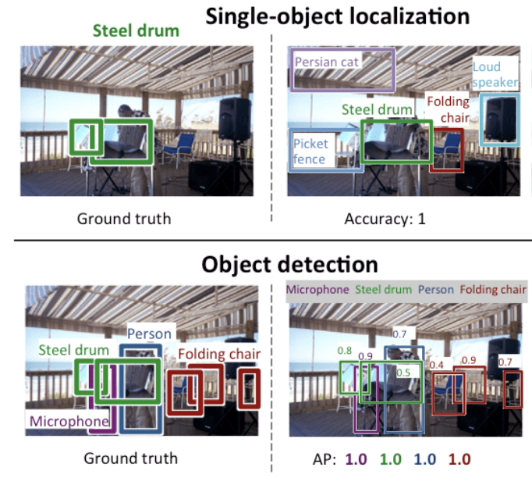
Machine Learning
Machine Learning Applied to Analyze the Presence of Segregation in Visual Imagery

Slide 7
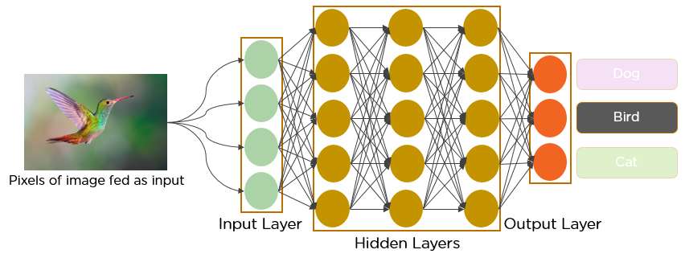
CNN

Slide 8
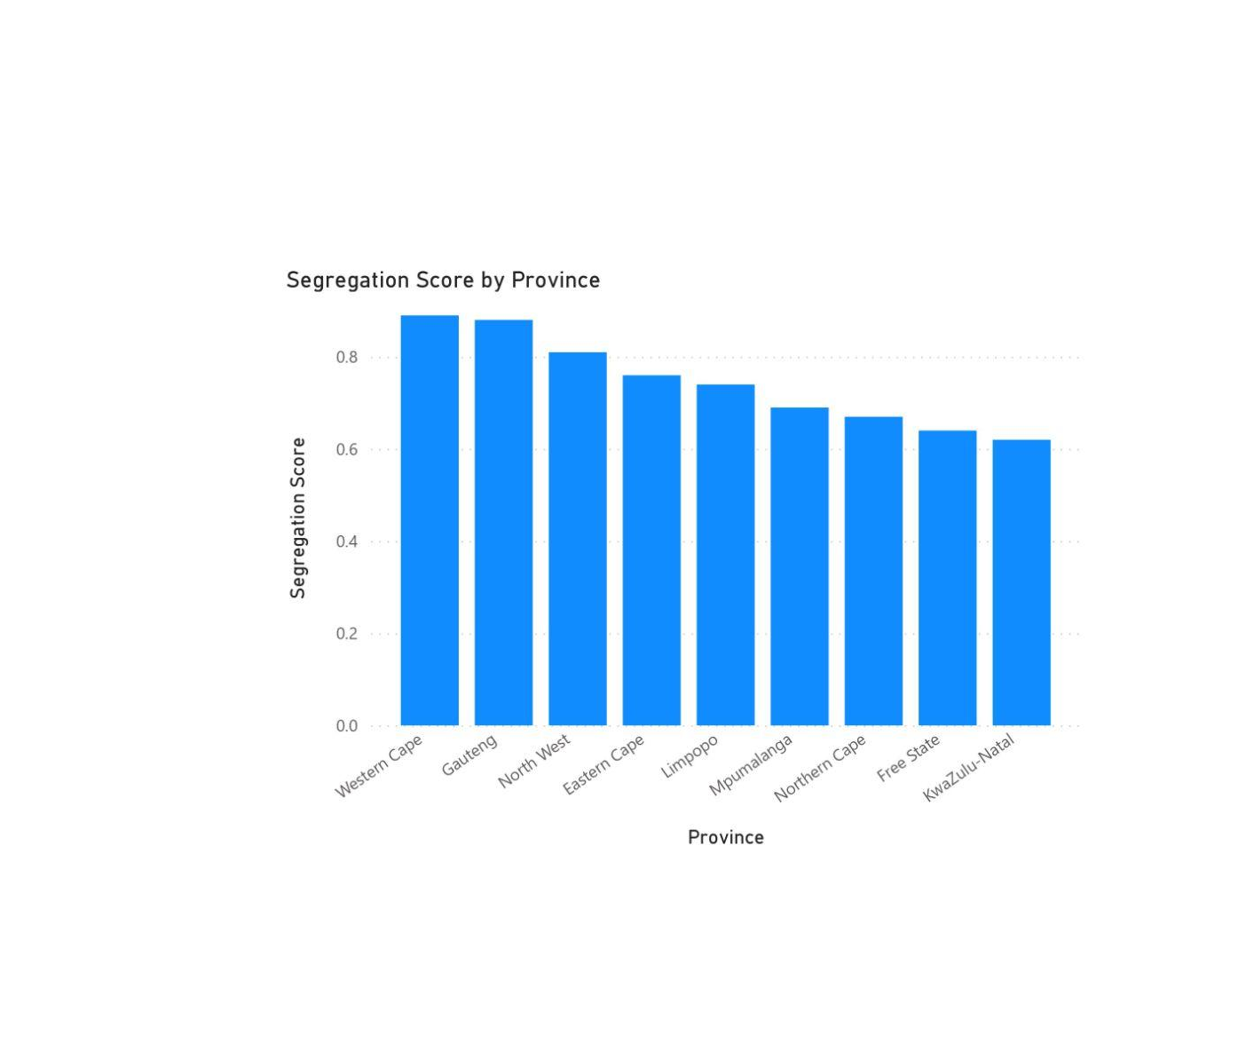
Results

Slide 9
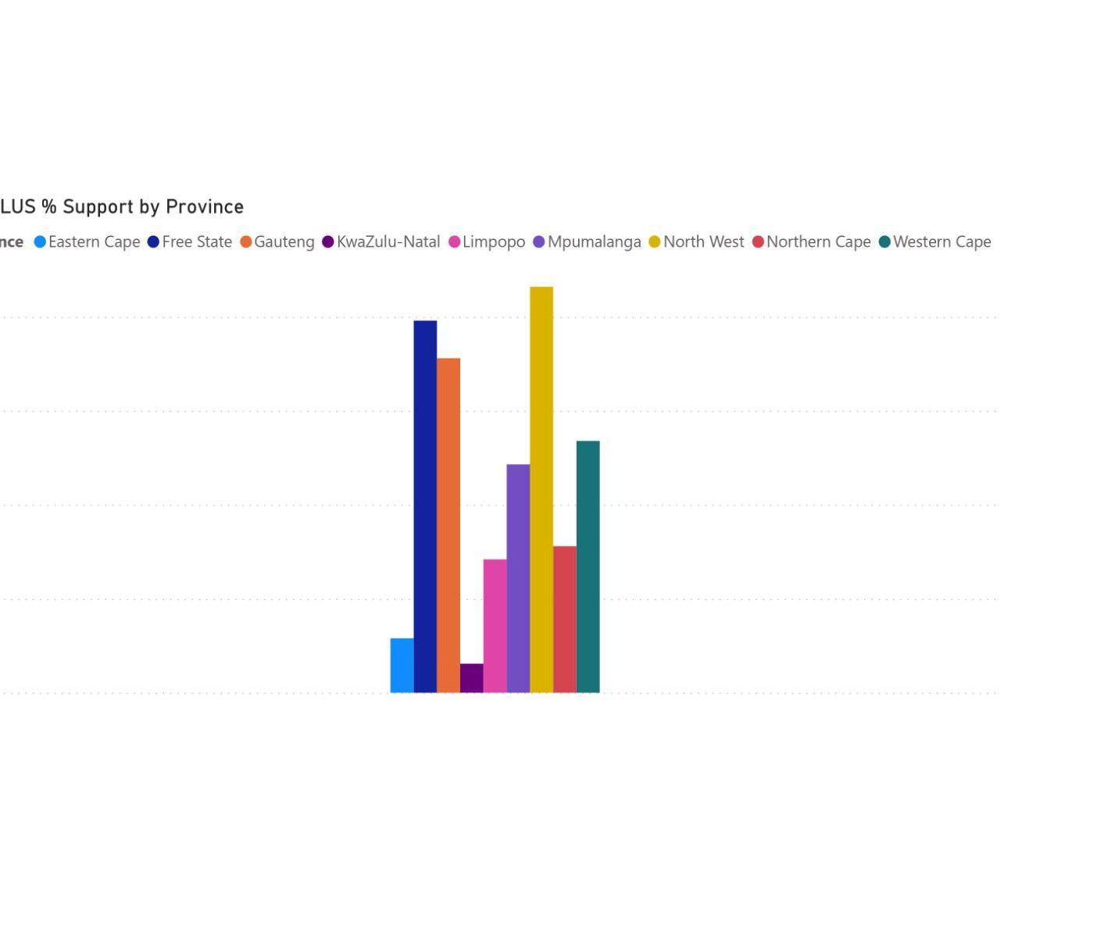
Results

Slide 10
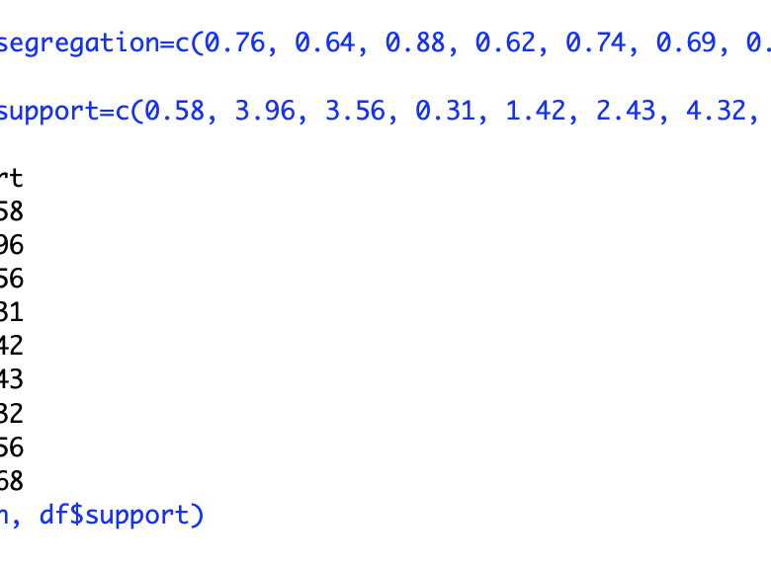
Results
Leveraging advanced statistical methodologies, we're empowered to derive profound historical and political insights concerning racial segregation.
Intriguingly, our analysis revealed that the degree of segregation exhibits only a weak correlation with contemporary political support for extreme-right political groups.
Technology: R

Slide 11
Questions?
email: g.haolin@columbia.edu

